Slide 1
EIP AI/ML Workshop
Topic #05
Supervised & Unsupervised Learning
Dr. Grzegorz Chmaj

Slide 2
Recall

Slide 3
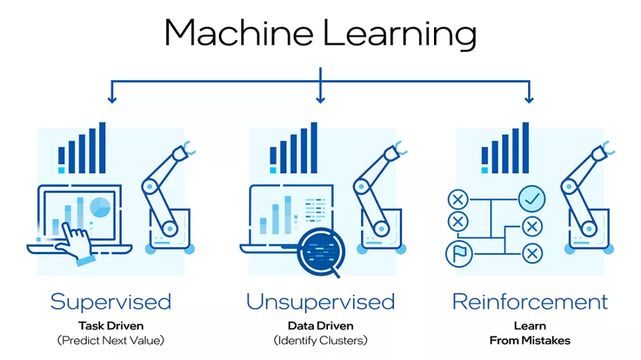
Learning
Learning
Learning is a procedure that consists of estimating the model parameters so that the learned model (algorithm) can perform a specific task
In Artificial Neural Networks, these parameters are the weight matrix (w_{i,j}’s)
3 types of learning considered here
Supervised
Unsupervised
Reinforcement

Slide 4
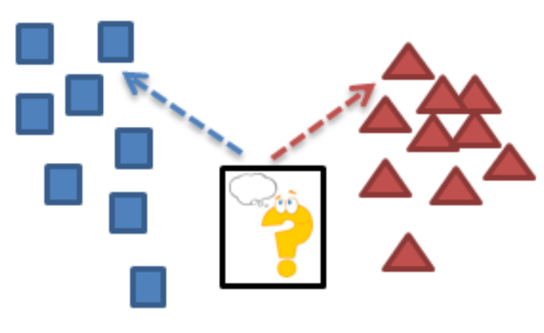
Learning
Supervised Learning: Training data includes desired outputs
Present the algorithm with a set of inputs and their corresponding outputs
See how closely the actual outputs match the desired ones
Note generalization error (bias, variance)
Iteratively modify the parameters to better approximate the desired outputs (gradient descent)
Supervised learning is a machine learning model that maps a specific input to an output using labeled training data (structured data). In simple terms, to train the algorithm to recognize pictures of cats, feed it pictures labeled as cats.

Slide 5
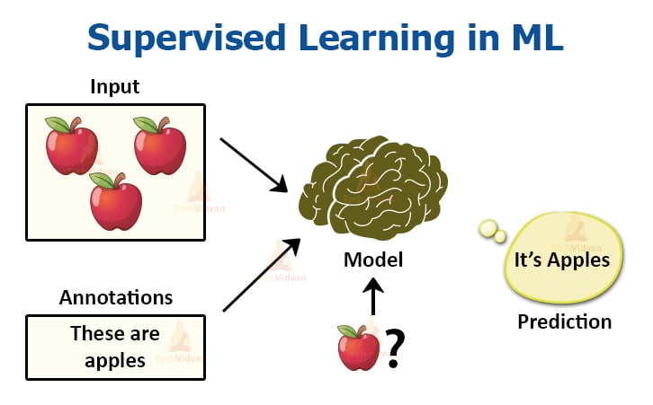
Learning
Supervised Learning
Example: decision trees tools that create rules
Prediction of future cases: Use the rule to predict the output for future inputs
Knowledge extraction: The rule is easy to understand
Compression: The rule is simpler than the data it explains
Outlier detection: Exceptions that are not covered by the rule, e.g., fraud

Slide 6

Learning
Unsupervised Learning: Training data does not include desired outputs
Algorithm learns internal representations and important features
Basic idea: Discover unknown structure in input data
Data clustering and dimension reduction
More generally: find the relationships/structure in the data set
No need for labeled data
The network itself finds the correlations in the data
Learning “what normally happens”
No output
Clustering: Grouping similar instances
Other applications: Summarization, Association Analysis
Example applications
Customer segmentation in CRM
Image compression: Color quantization
Bioinformatics: Learning motifs
Notes:
Semi-supervised learning Training data includes a few desired outputs

Slide 7
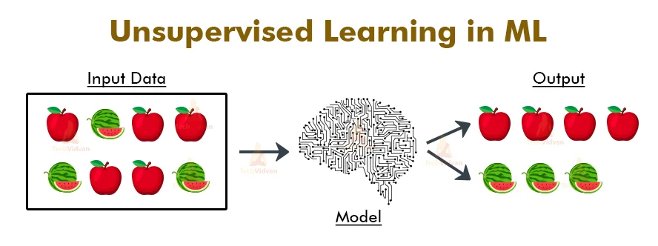
Learning
Unsupervised learning is a machine learning model that learns patterns based on unlabeled data (unstructured data).
Unlike supervised learning, the end result is not known ahead of time.
Rather, the algorithm learns from the data, categorizing it into groups based on attributes.
For instance, unsupervised learning is good at pattern matching and descriptive modeling.

Slide 8
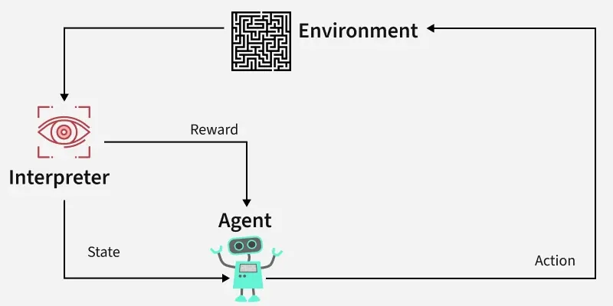
Learning
Reinforcement learning: Rewards from sequence of actions
Machine learning model that can be broadly described as “learn by doing.”
An “agent” learns to perform a defined task by trial and error (a feedback loop) until its performance is within a desirable range.
The agent receives positive reinforcement (reward) when it performs the task well and negative reinforcement (penalty) when it performs poorly.
An example of reinforcement learning would be teaching a robotic hand to pick up a ball.

Slide 9
Supervised learning

Slide 10
Supervised learning
Supervised learning – training a model using labeled data, where each input comes with a corresponding correct output
model learns by comparing its predictions with the actual answers provided in the training data.
over time, it adjusts itself to minimize errors and improve accuracy.
the goal of supervised learning is to make accurate predictions when given new, unseen data.
for example, if a model is trained to recognize handwritten digits, it will use what it learned to correctly identify new numbers it hasn't seen before.
Supervised learning can be applied in various forms, including supervised learning classification and supervised learning regression, making it a crucial technique in the field of artificial intelligence and supervised data mining.
Notes:
The process is like a teacher guiding a student—hence the term "supervised" learning.

Slide 11
Supervised learning
supervised learning can be applied in various forms, including supervised learning classification and supervised learning regression, making it a crucial technique in the field of artificial intelligence and supervised data mining.
a fundamental concept in supervised machine learning is learning a class from examples.
involves providing the model with examples where the correct label is known, such as learning to classify images of cats and dogs by being shown labeled examples of both.
the model then learns the distinguishing features of each class and applies this knowledge to classify new images.
Notes:
The process is like a teacher guiding a student—hence the term "supervised" learning.

Slide 12
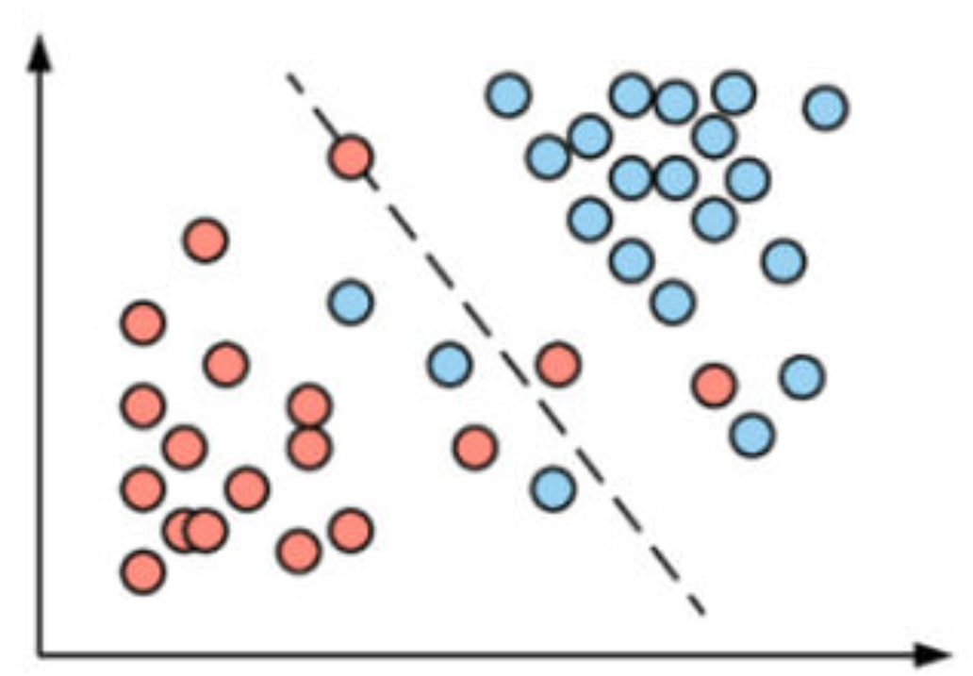
Supervised learning
Supervised learning algorithm consists of input features and corresponding output labels. The process works through:
Training Data: The model is provided with a training dataset that includes input data (features) and corresponding output data (labels or target variables).
Learning Process: The algorithm processes the training data, learning the relationships between the input features and the output labels.
this is achieved by adjusting the model's parameters to minimize the difference between its predictions and the actual labels.
Notes:
The process is like a teacher guiding a student—hence the term "supervised" learning.

Slide 13
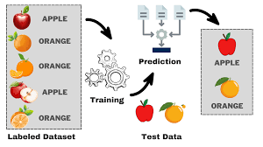
Supervised learning
After training, the model is evaluated using a test dataset to measure its accuracy and performance.
Then the model's performance is optimized by adjusting parameters and using techniques like cross-validation to balance bias and variance.
This ensures the model generalizes well to new, unseen data.
Notes:
The process is like a teacher guiding a student—hence the term "supervised" learning.

Slide 14
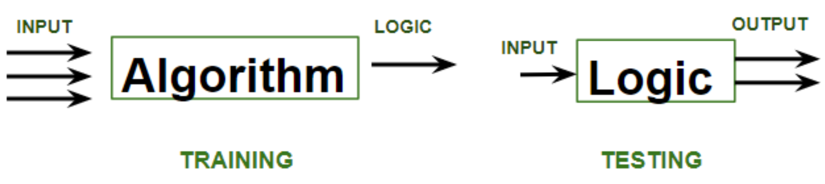
Supervised learning
Training phase involves feeding the algorithm labeled data, where each data point is paired with its correct output.
The algorithm learns to identify patterns and relationships between the input and output data.
Testing phase involves feeding the algorithm new, unseen data and evaluating its ability to predict the correct output based on the learned patterns.

Slide 15
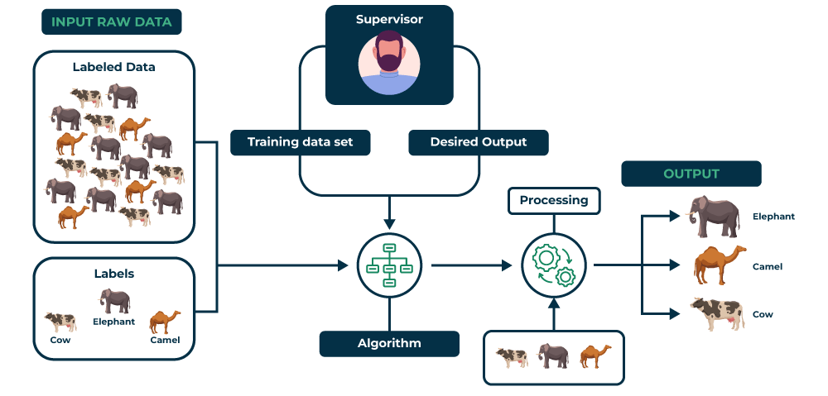
Supervised learning
Process:

Slide 16
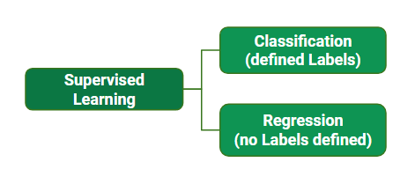
Supervised learning
Types of Supervised Learning in Machine Learning
Classification: Where the output is a categorical variable, e.g.:
spam vs. non-spam emails
yes vs. no
Regression: Where the output is a continuous variable e.g.:
predicting house prices
predicting stock prices

Slide 17
Supervised learning
Classification

Slide 18
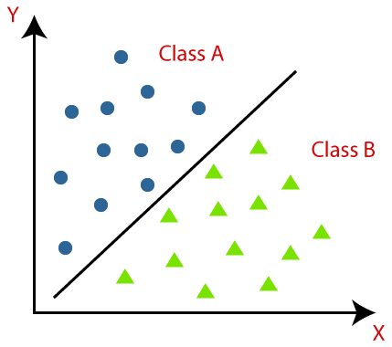
Supervised learning
Classification – teaches machine to sort things into categories.
It learns by looking at examples with labels
like emails marked "spam" or "not spam"
After learning, it can decide which category new items belong to, like identifying if a new email is spam or not.
For example a classification model might be trained on dataset of images labeled as either dogs or cats and it can be used to predict the class of new and unseen images as dogs or cats based on their features such as color, texture and shape.

Slide 19
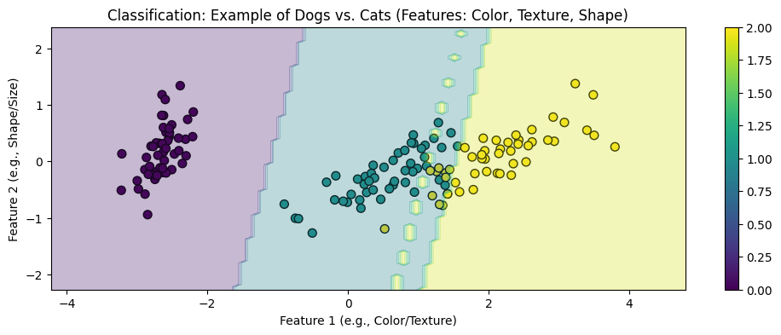
Supervised learning – Classification
Explaining classification in ML:
horizontal axis represents the combined values of color and texture features
vertical axis represents the combined values of shape and size features.

Slide 20
Supervised learning – Classification
Each colored dot in the plot represents an individual image, with the color indicating whether the model predicts the image to be a dog or a cat.

Slide 21
Supervised learning – Classification
The shaded areas in the plot show the decision boundary, which is the line or region that the model uses to decide which category (dog or cat) an image belongs to. The model classifies images on one side of the boundary as dogs and on the other side as cats, based on their features.

Slide 22
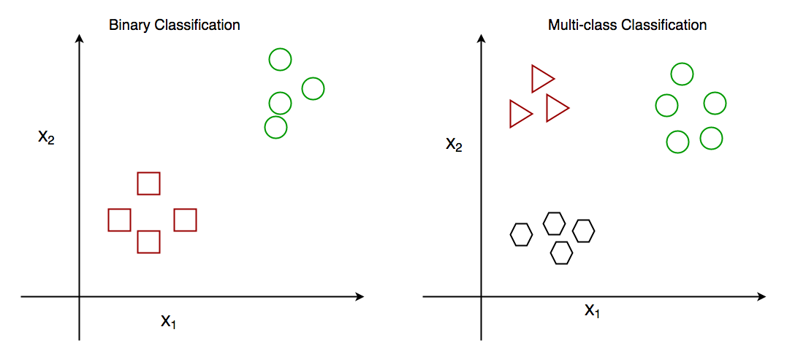
Supervised learning
Types of Classification
classification in machine learning – the process of sorting data into categories based on specific features or characteristics.
There are different types of classification problems depending on how many categories (or classes) we are working with and how they are organized.
There are two main classification types in machine learning:
binary classification
multiclass classification

Slide 23
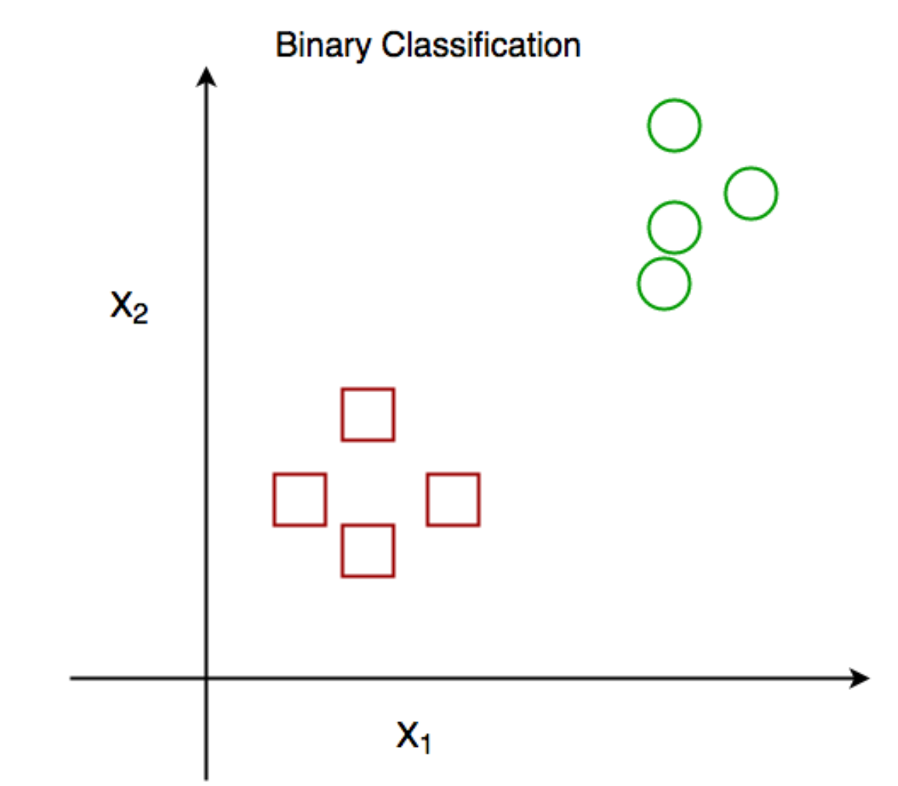
Supervised learning – types of classification
Binary Classification – simplest kind of classification
In binary classification, the goal is to sort the data into two distinct categories (simple choice between two options)
E.g.: system that sorts emails into either spam or not spam.
It works by looking at different features of the email like certain keywords or sender details, and decides whether it’s spam or not.
It only chooses between these two options.

Slide 24
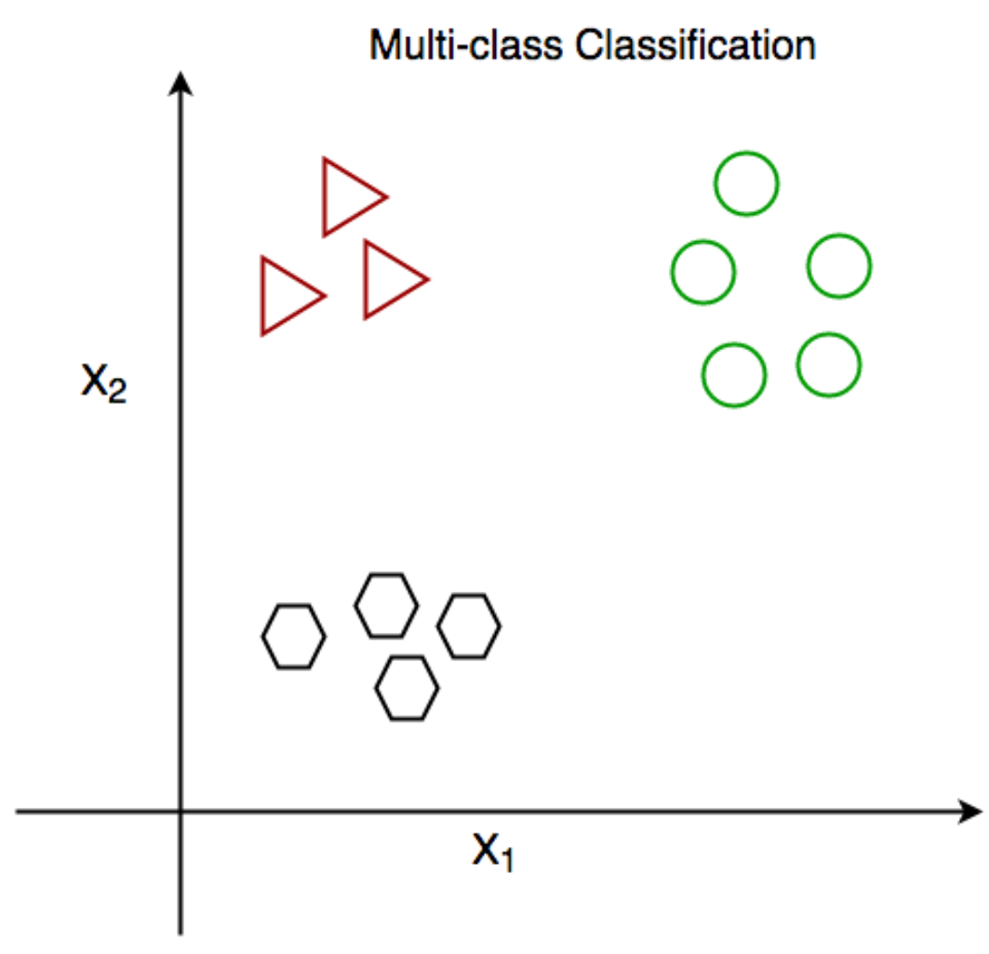
Supervised learning – types of classification
Multiclass Classification – the data needs to be sorted into more than two categories.
the model picks the one that best matches the input.
E.g.: image recognition system that sorts pictures of animals into categories like cat, dog, and bird.
machine looks at the features in the image (like shape, color, or texture) and chooses which animal the picture is most likely to be based on the training it received.

Slide 25
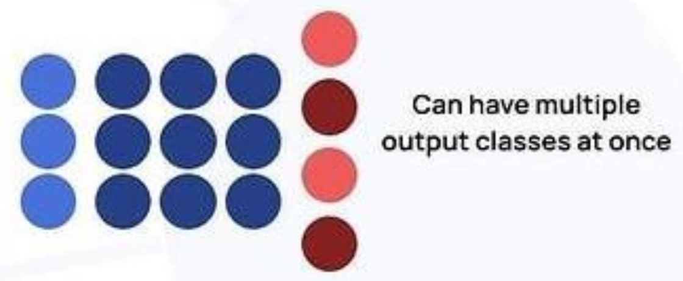
Supervised learning – types of classification
Multi-Label Classification – single piece of data can belong to multiple categories at once.
unlike multiclass classification where each data point belongs to only one class, multi-label classification allows datapoints to belong to multiple classes.
E.g.: a movie recommendation system could tag a movie as both action and comedy.
the system checks various features (like movie plot, actors, or genre tags) and assigns multiple labels to a single piece of data, rather than just one.

Slide 26
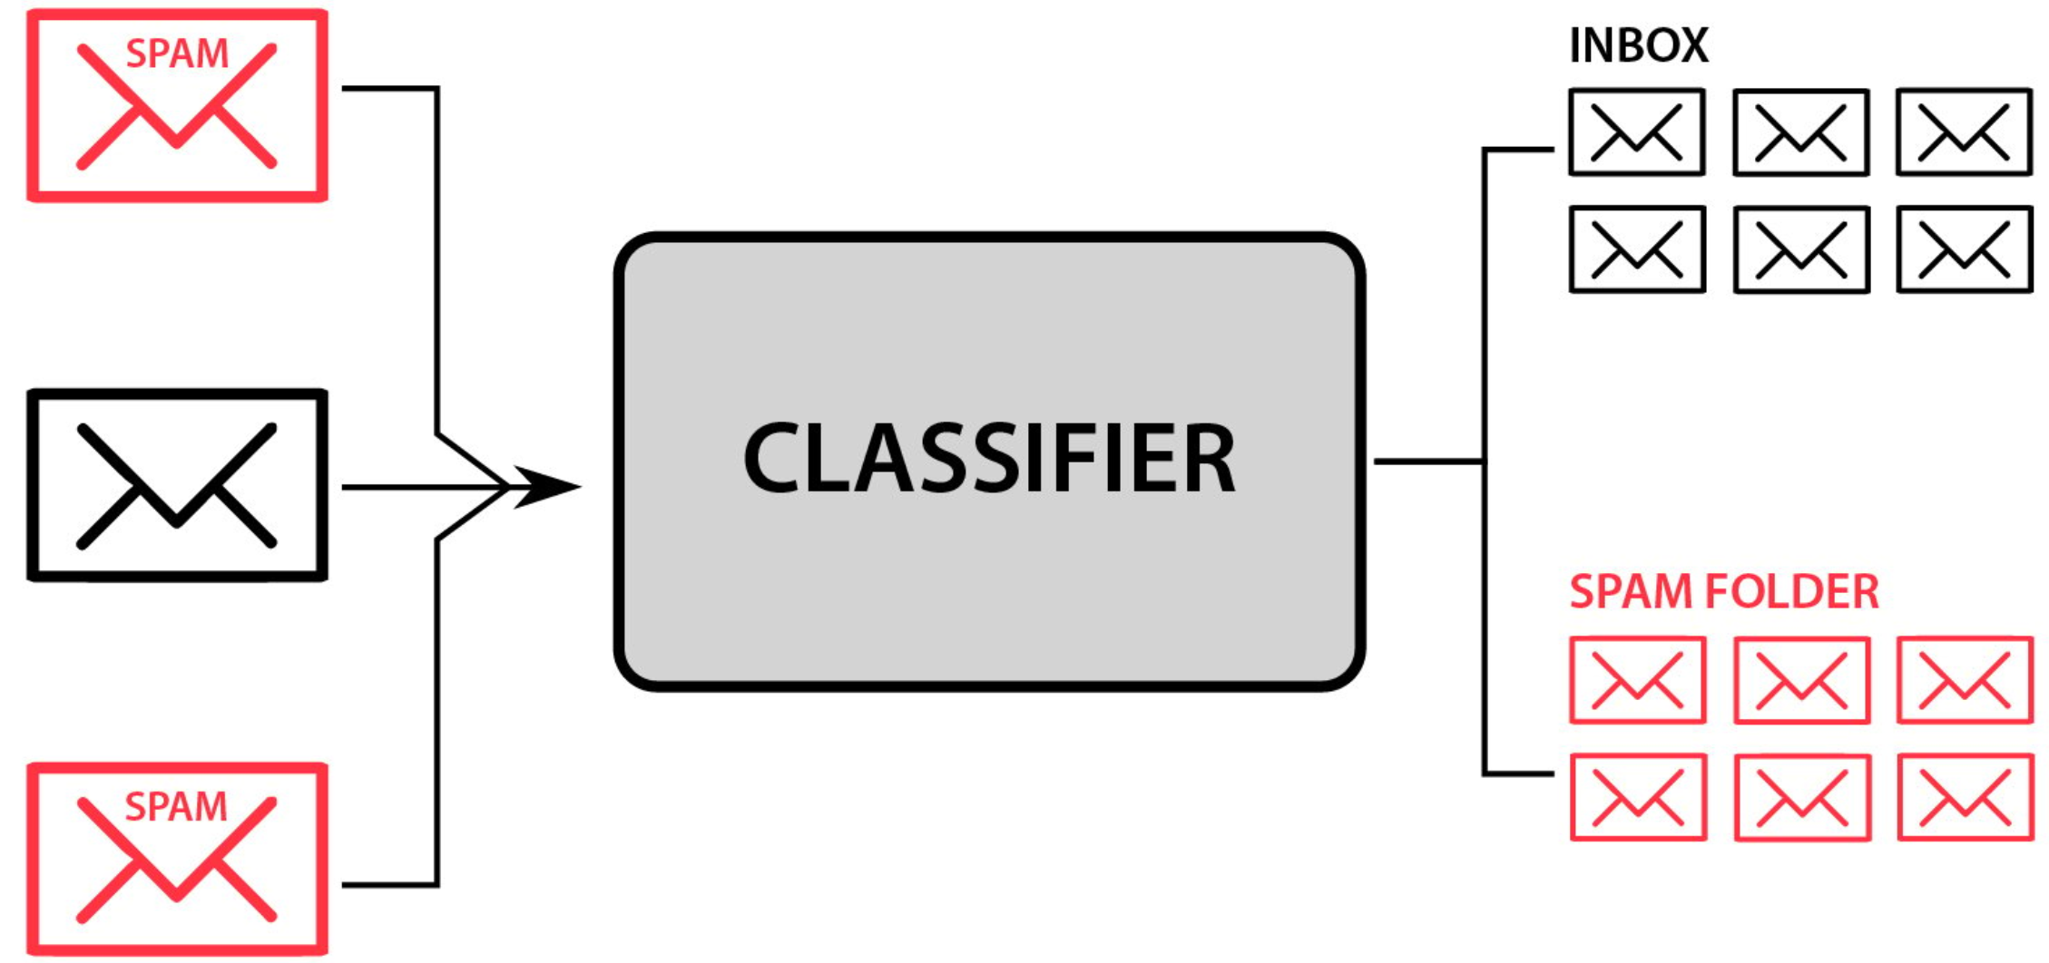
Supervised learning – classification operation
Classification – steps:
1. Data Collection: You start with a dataset where each item is labeled with the correct class (for example, "cat" or "dog").
2. Feature Extraction: The system identifies features (like color, shape, or texture) that help distinguish one class from another. These features are what the model uses to make predictions.
3. Model Training: Classification - machine learning algorithm uses the labeled data to learn how to map the features to the correct class. It looks for patterns and relationships in the data.

Slide 27
Supervised learning – classification operation
Classification – steps (2):
4. Model Evaluation: Once the model is trained, it's tested on new, unseen data to check how accurately it can classify the items.
5. Prediction: After being trained and evaluated, the model can be used to predict the class of new data based on the features it has learned.
6. Model Evaluation: Evaluating a classification model is a key step in machine learning. It helps us check how well the model performs and how good it is at handling new, unseen data. Depending on the problem and needs we can use different metrics to measure its performance.

Slide 28
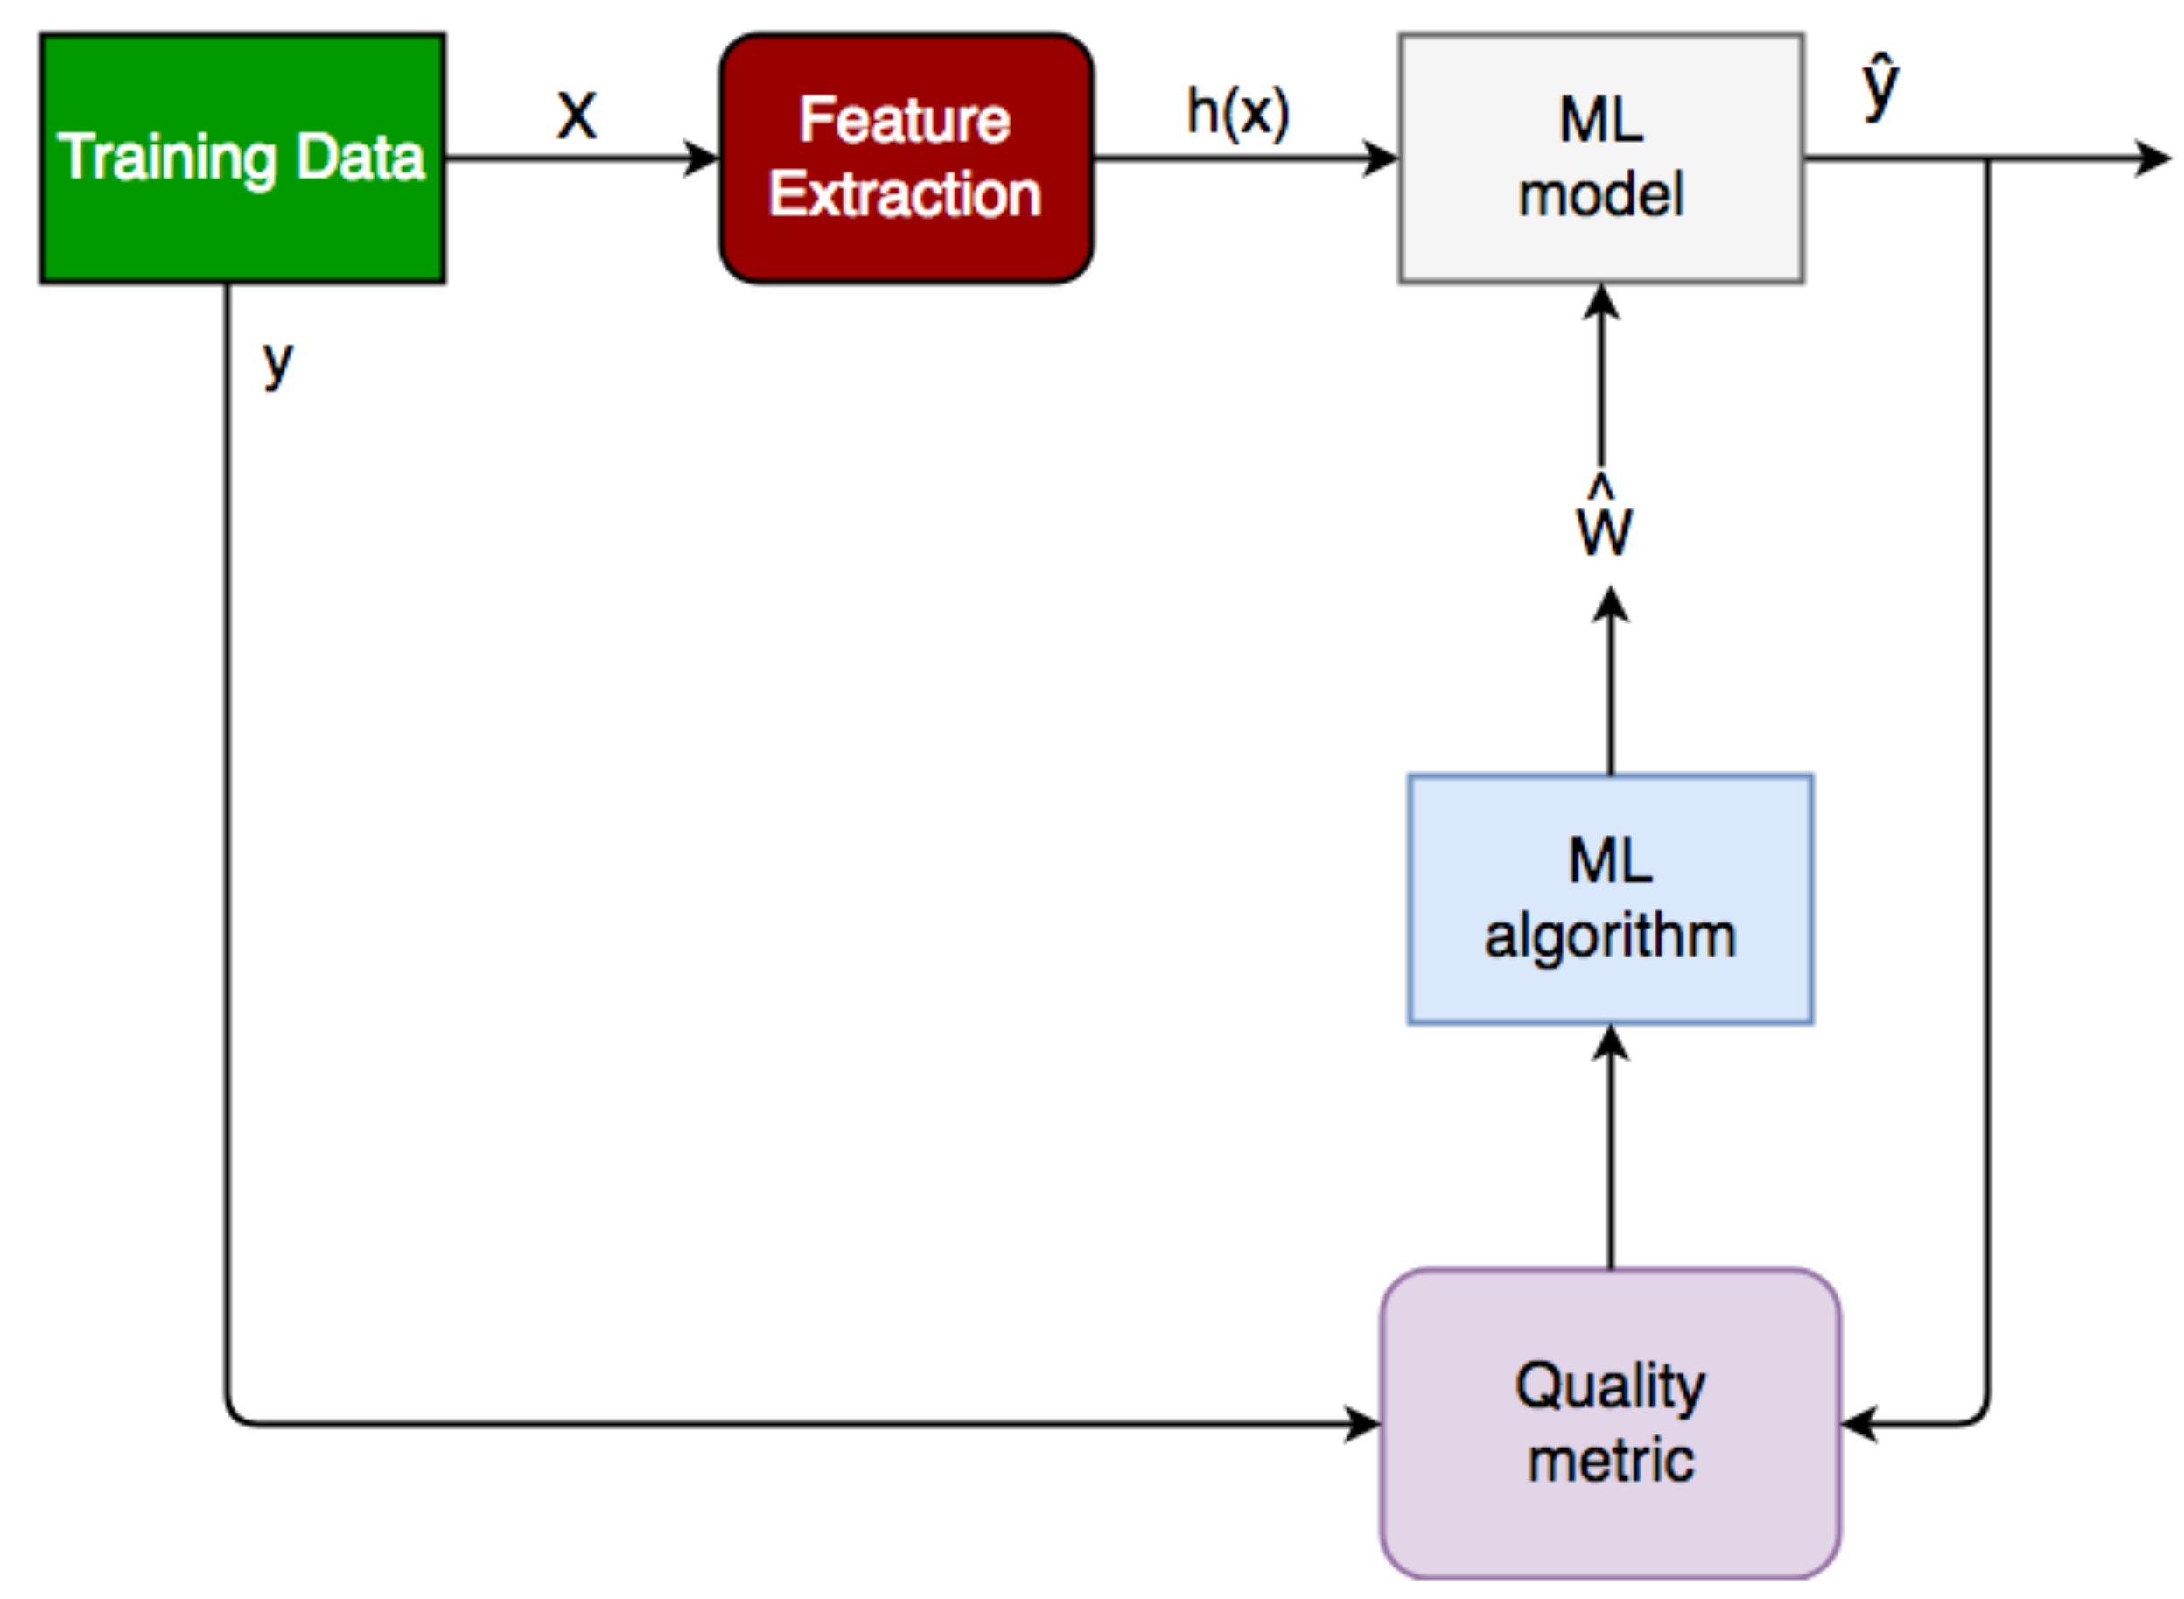
Supervised learning – classification operation
Classification – steps (3):
Notes:
If the quality metric is not satisfactory, the ML algorithm or hyperparameters can be adjusted, and the model is retrained. This iterative process continues until a satisfactory performance is achieved. In short, classification in machine learning is all about using existing labeled data to teach the model how to predict the class of new, unlabeled data based on the patterns it has learned.

Slide 29
Supervised learning
Regression

Slide 30
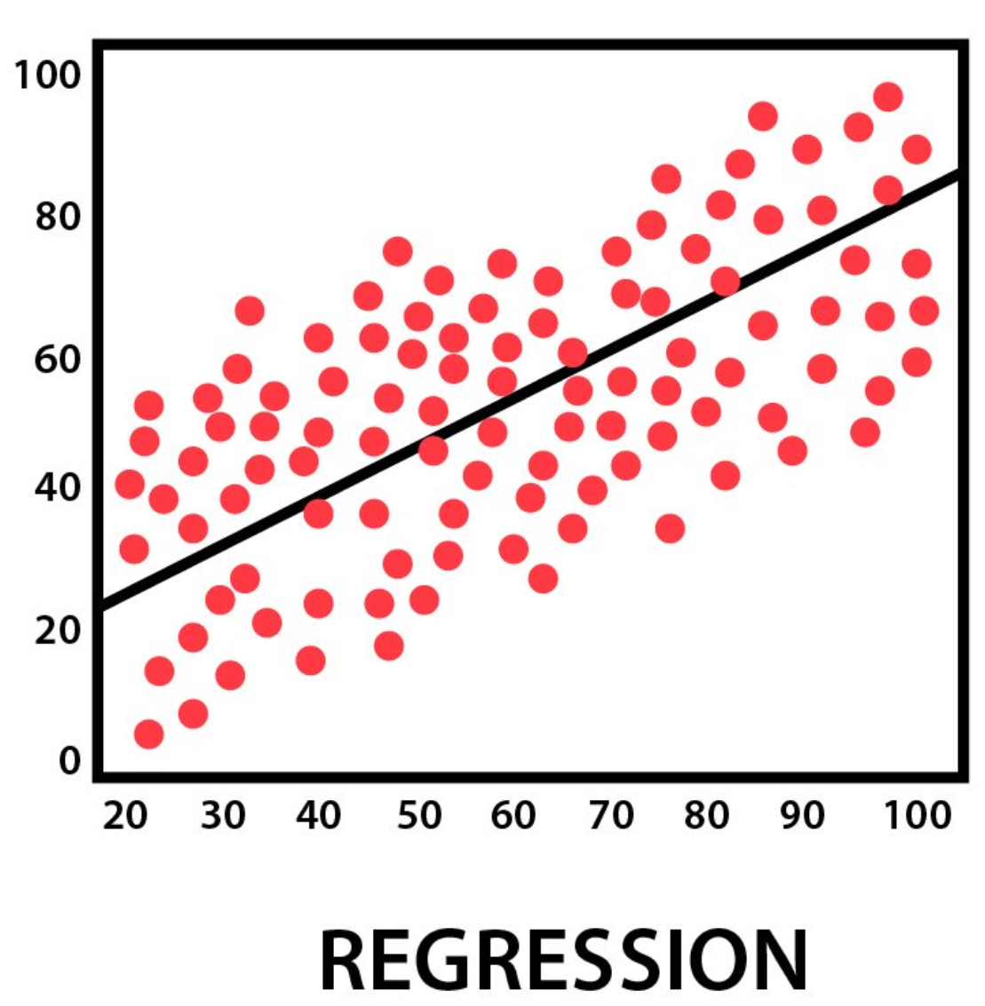
Supervised learning – regression
Regression in machine learning refers to a supervised learning technique where the goal is to predict a continuous numerical value based on one or more independent features.
It finds relationships between variables so that predictions can be made.
Two types of variables are present in regression:
Dependent Variable (Target): The variable we are trying to predict e.g house price.
Independent Variables (Features): The input variables that influence the prediction e.g locality, number of rooms.
Regression analysis problem works with if output variable is a real or continuous value such as “salary” or “weight”.
Many different regression models can be used but the simplest model in them is linear regression.

Slide 31
Supervised learning – regression types
Linear Regression – assumes that there is a linear relationship between the independent and dependent variables
Multiple Linear Regression – extends simple linear regression by using multiple independent variables to predict target variable.
For example predicting the price of a house based on multiple features such as size, location, number of rooms, etc.
Polynomial regression is used to model with non-linear relationships between the dependent variable and the independent variables.
It adds polynomial terms to the linear regression model to capture more complex relationships.
For example when we want to predict a non-linear trend like population growth over time we use polynomial regression.

Slide 32
Supervised learning – regression types
Ridge & lasso regression are regularized versions of linear regression that help avoid overfitting by penalizing large coefficients.
SVR is a type of regression algorithm that is based on the SVM algorithm, works by finding a hyperplane that minimizes the sum of the squared residuals between the predicted and actual values.
Decision tree Uses a tree-like structure to make decisions where each branch of tree represents a decision and leaves represent outcomes.
Random Forest is a ensemble method that builds multiple decision trees and each tree is trained on a different subset of the training data. The final prediction is made by averaging the predictions of all of the trees.

Slide 33
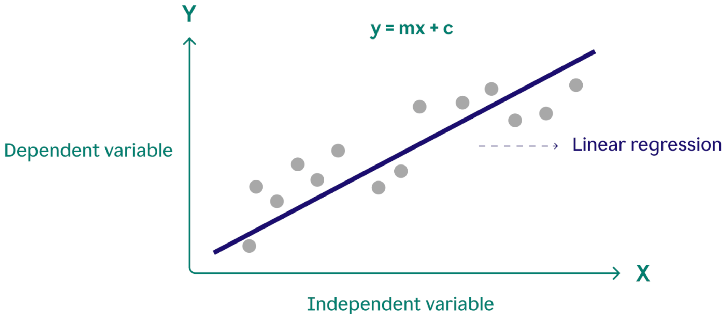
Supervised learning – regression types
Linear Regression – one of the simplest and most widely used statistical models.
assumes that there is a linear relationship between the independent and dependent variables.
means that the change in the dependent variable is proportional to the change in the independent variables.
For example predicting the price of a house based on its size.

Slide 34
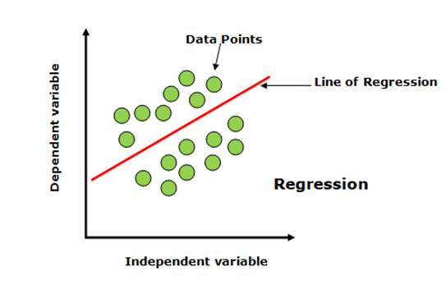
Supervised learning – linear regression
For example we want to predict a student's exam score based on how many hours they studied. We observe that as students study more hours, their scores go up. In the example of predicting exam scores based on hours studied. Here
Independent variable (input): Hours studied because it's the factor we control or observe.
Dependent variable (output): Exam score because it depends on how many hours were studied.

Slide 35
Supervised learning – linear regression
Here’s why linear regression is important:
Simplicity and Interpretability: It’s easy to understand and interpret, making it a starting point for learning about machine learning.
Predictive Ability: Helps predict future outcomes based on past data, making it useful in various fields like finance, healthcare and marketing.
Basis for Other Models: Many advanced algorithms, like logistic regression or neural networks, build on the concepts of linear regression.
Efficiency: It’s computationally efficient and works well for problems with a linear relationship.
Widely Used: It’s one of the most widely used techniques in both statistics and machine learning for regression tasks.
Analysis: It provides insights into relationships between variables (e.g., how much one variable influences another).

Slide 36
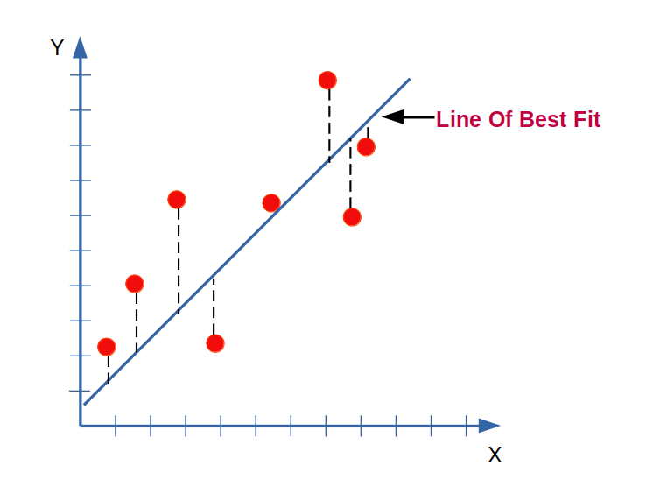
Supervised learning – linear regression
Best Fit Line in Linear Regression
In linear regression, the best-fit line is the straight line that most accurately represents the relationship between the independent variable (input) and the dependent variable (output).
It is the line that minimizes the difference between the actual data points and the predicted values from the model.

Slide 37
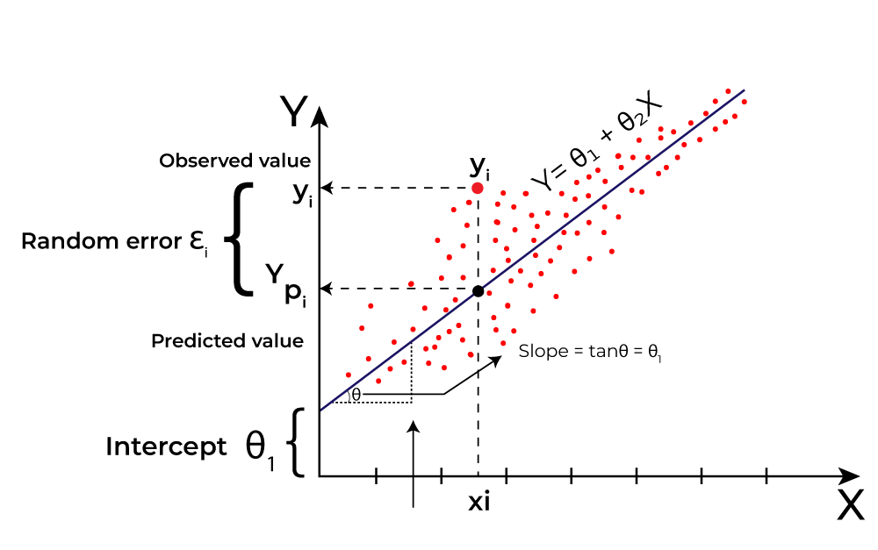
Supervised learning – linear regression
Goal of the Best-Fit Line
The goal of linear regression is to find a straight line that minimizes the error (the difference) between the observed data points and the predicted values.
This line helps us predict the dependent variable for new, unseen data.

Slide 38
Supervised learning – linear regression
Here Y is called a dependent or target variable and X is called an independent variable also known as the predictor of Y. There are many types of functions or modules that can be used for regression. A linear function is the simplest type of function. Here, X may be a single feature or multiple features representing the problem.

Slide 39
Supervised learning
Training

Slide 40
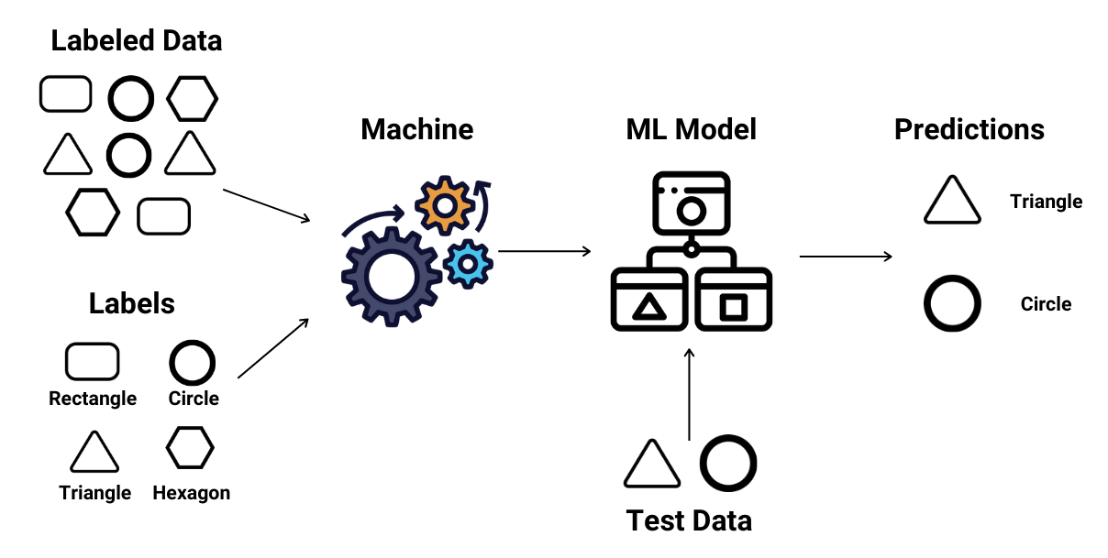
Supervised learning
Training
While training the model, data is usually split in the ratio of 80:20 i.e. 80% as training data and the rest as testing data.
In training data, input as well as output is fed for 80% of data
The model learns from training data only
different supervised learning algorithms are used to build our model.

Slide 41
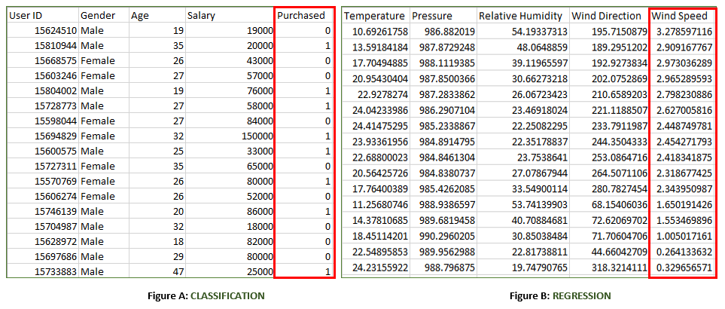
Supervised learning
Figure A: It is a dataset of a shopping store that is useful in predicting whether a customer will purchase a particular product under consideration or not based on his/ her gender, age, and salary.
Input: Gender, Age, Salary
Output: Purchased i.e. 0 or 1; 1 means yes the customer will purchase and 0 means that the customer won't purchase it.

Slide 42
Supervised learning
Figure B: It is a Meteorological dataset that serves the purpose of predicting wind speed based on different parameters.
Input: Dew Point, Temperature, Pressure, Relative Humidity, Wind Direction
Output: Wind Speed

Slide 43
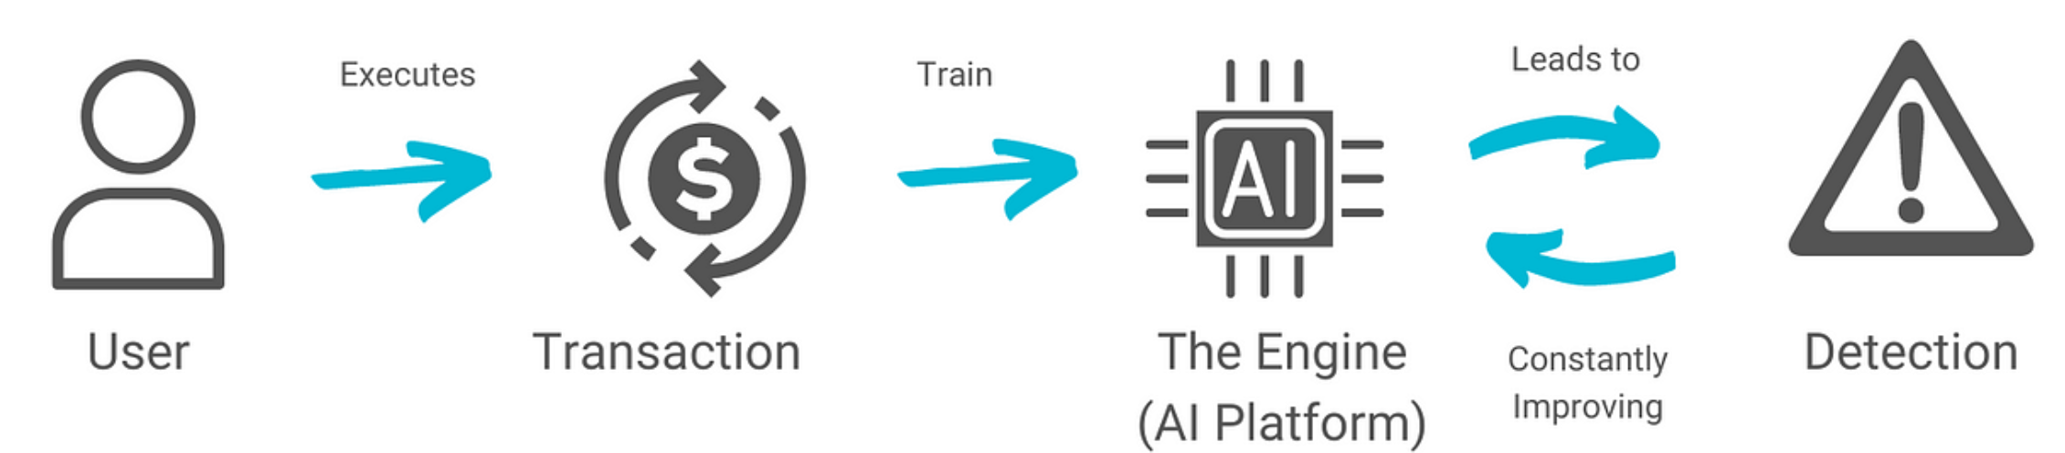
Supervised learning
Practical Examples of Supervised learning
Fraud Detection in Banking: Utilizes supervised learning algorithms on historical transaction data, training models with labeled datasets of legitimate and fraudulent transactions to accurately predict fraud patterns.
Parkinson Disease Prediction: Parkinson’s disease is a progressive disorder that affects the nervous system and the parts of the body controlled by the nerves.
Cancer cell classification: Implements supervised learning for cancer cells based on their features, and identifying them if they are ‘malignant’ or ‘benign.
Stock Price Prediction: Applies supervised learning to predict a signal that indicates whether buying a particular stock will be helpful or not.

Slide 44
Supervised learning
Supervised Machine Learning Algorithms
Supervised learning can be further divided into several different types, each with its own unique characteristics and applications. Here are some of the most common types of supervised learning algorithms:
Linear Regression: Linear regression is a type of supervised learning regression algorithm that is used to predict a continuous output value. It is one of the simplest and most widely used algorithms in supervised learning.
Logistic Regression: Logistic regression is a type of supervised learning classification algorithm that is used to predict a binary output variable.

Slide 45
Supervised learning
Supervised Machine Learning Algorithms (2)
Decision Trees: Decision tree is a tree-like structure that is used to model decisions and their possible consequences. Each internal node in the tree represents a decision, while each leaf node represents a possible outcome.
Random Forests: Random forests again are made up of multiple decision trees that work together to make predictions. Each tree in the forest is trained on a different subset of the input features and data. The final prediction is made by aggregating the predictions of all the trees in the forest.
Support Vector Machine(SVM): The SVM algorithm creates a hyperplane to segregate n-dimensional space into classes and identify the correct category of new data points. The extreme cases that help create the hyperplane are called support vectors, hence the name Support Vector Machine

Slide 46
Supervised learning
Supervised Machine Learning Algorithms (3)
K-Nearest Neighbors (KNN): KNN works by finding k training examples closest to a given input and then predicts the class or value based on the majority class or average value of these neighbors. The performance of KNN can be influenced by the choice of k and the distance metric used to measure proximity.
Gradient Boosting: Gradient Boosting combines weak learners, like decision trees, to create a strong model. It iteratively builds new models that correct errors made by previous ones.
Naive Bayes Algorithm: The Naive Bayes algorithm is a supervised machine learning algorithm based on applying Bayes' Theorem with the “naive” assumption that features are independent of each other given the class label.

Slide 47
Supervised learning
Supervised Machine Learning Algorithms – Comparison
Algorithm | Regression, Classification | Purpose | Method | Use Cases
Linear Regression | Regression | Predict continuous output values | Linear equation minimizing sum of squares of residuals | Predicting continuous values
Logistic Regression | Classification | Predict binary output variable | Logistic function transforming linear relationship | Binary classification tasks
Decision Trees | Both | Model decisions and outcomes | Tree-like structure with decisions and outcomes | Classification and Regression tasks
Random Forests | Both | Improve classification and regression accuracy | Combining multiple decision trees | Reducing overfitting, improving prediction accuracy
Notes:
These types of supervised learning in machine learning vary based on the problem you're trying to solve and the dataset you're working with. In classification problems, the task is to assign inputs to predefined classes, while regression problems involve predicting numerical outcomes.

Slide 48
Supervised learning
Supervised Machine Learning Algorithms – Comparison
Algorithm | Regression, Classification | Purpose | Method | Use Cases
SVM | Both | Create hyperplane for classification or predict continuous values | Maximizing margin between classes or predicting continuous values | Classification and Regression tasks
KNN | Both | Predict class or value based on k closest neighbors | Finding k closest neighbors and predicting based on majority or average | Classification and Regression tasks, sensitive to noisy data
Gradient Boosting | Both | Combine weak learners to create strong model | Iteratively correcting errors with new models | Classification and Regression tasks to improve prediction accuracy
Naive Bayes | Classification | Predict class based on feature independence assumption | Bayes' theorem with feature independence assumption | Text classification, spam filtering, sentiment analysis, medical
Notes:
These types of supervised learning in machine learning vary based on the problem you're trying to solve and the dataset you're working with. In classification problems, the task is to assign inputs to predefined classes, while regression problems involve predicting numerical outcomes.

Slide 49
Supervised learning
Training a Supervised Learning Model: Key Steps
The goal of Supervised learning is to generalize well to unseen data.
Training a model for supervised learning involves several crucial steps, each designed to prepare the model to make accurate predictions or decisions based on labeled data.
1. Data Collection and Preprocessing: Gather a labeled dataset consisting of input features and target output labels. Clean the data, handle missing values, and scale features as needed to ensure high quality for supervised learning algorithms.
2. Splitting the Data: Divide the data into training set (80%) and the test set (20%).

Slide 50
Supervised learning
Training a Supervised Learning Model: Key Steps
3. Choosing the Model: Select appropriate algorithms based on the problem type. This step is crucial for effective supervised learning in AI.
4. Training the Model: Feed the model input data and output labels, allowing it to learn patterns by adjusting internal parameters.
5. Evaluating the Model: Test the trained model on the unseen test set and assess its performance using various metrics.

Slide 51
Supervised learning
Training a Supervised Learning Model: Key Steps
6. Hyperparameter Tuning: Adjust settings that control the training process (e.g., learning rate) using techniques like grid search and cross-validation.
7. Final Model Selection and Testing: Retrain the model on the complete dataset using the best hyperparameters testing its performance on the test set to ensure readiness for deployment.
8. Model Deployment: Deploy the validated model to make predictions on new, unseen data.

Slide 52
Supervised learning
The power of supervised learning lies in its ability to accurately predict patterns and make data-driven decisions.
Advantages of supervised learning: Supervised learning excels in accurately predicting patterns and making data-driven decisions.
Labeled training data is crucial for enabling supervised learning models to learn input-output relationships effectively.
Supervised machine learning encompasses tasks such as supervised learning classification and supervised learning regression.
Applications include complex problems like image recognition and natural language processing.

Slide 53
Supervised learning
Advantages of Supervised Learning (2)
Established evaluation metrics (accuracy, precision, recall, F1-score) are essential for assessing supervised learning model performance.
Advantages of supervised learning include creating complex models for accurate predictions on new data.
Supervised learning requires substantial labeled training data, and its effectiveness hinges on data quality and representativeness.

Slide 54
Supervised learning
Disadvantages of Supervised Learning
Despite the benefits of supervised learning methods, there are notable disadvantages of supervised learning:
Overfitting: Models can overfit training data, leading to poor performance on new data due to capturing noise in supervised machine learning.
Feature Engineering: Extracting relevant features is crucial but can be time-consuming and requires domain expertise in supervised learning applications.
Bias in Models: Bias in the training data may result in unfair predictions in supervised learning algorithms.
Dependence on Labeled Data: Supervised learning relies heavily on labeled training data, which can be costly and time-consuming to obtain, posing a challenge for supervised learning techniques.

Slide 55
Unsupervised learning

Slide 56
Unsupervised learning
Unsupervised learning – part of machine learning which works differently from supervised because there is no teacher (supervisor) involved to guide the machine.
In this approach the machine is given with data that has no labels or categories.
It analyzes the data on its own to find patterns, groups or relationships without any prior knowledge.
The machine learns by discovering hidden structures within the data without being told what the correct output should be.
For example, unsupervised learning can analyze animal data and group the animals by their traits and behavior. These groups might represent different species which allows the machine to organize animals without any prior labels or categories.

Slide 57
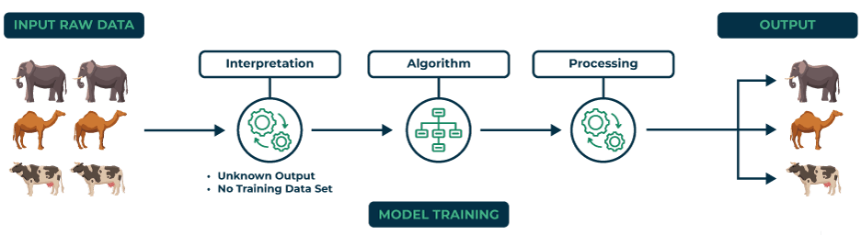
Unsupervised learning
Example: we have a machine learning model trained on many unlabeled images of dogs and cats. The model has never seen any labeled example that says “dog” or “cat” before so it doesn’t know how these animals look like.
if we give the model a new image that contains both dogs and cats it won’t be able to directly label them as “dog” or “cat.” It will group parts of the image based on similarities and differences in features like shape or texture.

Slide 58
Unsupervised learning
It might separate the image into two groups one with dog-like features and other with cat-like features.
This happens because unsupervised learning doesn’t rely on prior knowledge or training with labeled data. It finds patterns and organizes data on its own helps in discovering information that wasn’t given before.

Slide 59
Unsupervised learning – Types
Types of Unsupervised Learning
1. clustering – is used to group similar data points together.
clustering algorithms work by repeatedly moving data points closer to the center of their group (cluster) and farther from points in other groups.
this helps the algorithm to create clear and meaningful clusters.
Some popular clustering algorithms include:
K-means clustering
Hierarchical clustering
Principal Component Analysis (PCA)
Singular Value Decomposition (SVD)
Independent Component Analysis
Gaussian Mixture Models (GMMs)
Density-Based Spatial Clustering of Applications with Noise (DBSCAN)

Slide 60
Unsupervised learning – Types
Types of Unsupervised Learning (2)
2. association rule learning – used to find patterns and relationships between different items in a dataset.
It looks for rules like “people who buy X often also buy Y”.
Some common association rule learning algorithms include:
Apriori Algorithm
Eclat Algorithm
FP-Growth Algorithm

Slide 61
Unsupervised learning
Application of Unsupervised learning
Anomaly detection: It can identify unusual patterns or behaviors in data helps in the detection of fraud, security breaches or system problems.
Scientific discovery: It can show hidden relationships and patterns in scientific data which leads to new insights and ideas.
Recommendation systems: It finds similarities in user behavior and preferences to recommend products, movies or music that align with their interests.
Customer segmentation: It can identify groups of customers with similar characteristics which allows businesses to target marketing campaigns and improve customer service more effectively.

Slide 62
Unsupervised learning
Advantages of Unsupervised learning
It doesn’t need labeled data so we can start working with large datasets more easily and quickly.
This handles large amounts of data and reduce it into simpler forms without losing important patterns which makes it manageable and efficient.
It discovers patterns and relationships in the data that were previously unknown which offers valuable insights.
By analyzing unlabeled data, it shows meaningful trends and groups that help us to understand our data deeply.

Slide 63
Supervised vs Unsupervised learning

Slide 64
Supervised vs Unsupervised learning
Comparison of Supervised and Unsupervised learning
Computational Complexity | Simpler method | Computationally complex
Input Data | They are trained on labeled data. | They are trained on unlabeled data.
Computational Complexity | Simpler method | Computationally complex
Accuracy | Highly accurate | Less accurate
No. of classes | No. of classes is known | No. of classes is not known
Data Analysis | Uses offline analysis | Uses real-time analysis of data
Algorithms used | Linear and Logistics regression, KNN Random forest, multi-class classification, decision tree, Support Vector Machine, Neural Network etc. | K-Means clustering, Hierarchical clustering, Apriori algorithm etc.

Slide 65
Supervised vs Unsupervised learning
Comparison of Supervised and Unsupervised learning
Computational Complexity | Simpler method | Computationally complex
Output | Desired output is given. | Desired output is not given.
Training data | Use training data to infer model. | No training data is used.
Complex model | It is not possible to learn larger and more complex models with supervised learning. | It is possible to learn larger and more complex models with unsupervised learning.
Model | We can test our model. | We can not test our model.
Supervision | Supervised learning needs supervision to train the model. | Unsupervised learning does not need any supervision to train the model.

Slide 66
Supervised vs Unsupervised learning
Comparison of Supervised and Unsupervised learning
Computational Complexity | Simpler method | Computationally complex
Classification | Divided into two types: Regression Classification | Divided into two types: Clustering Association
Feedback | It has feedback mechanism. | It has no feedback mechanism.
Time Consumption | It's more time consuming. | It's less time consuming.
Example | Optical character recognition. | Find a face in an image.

